Slide 1

International Enterprise
Multi-Dimensional Project Management
Part 2
WBS - Risks – Planning - Scheduling
Notes:
Multi-Dimensional Project Management 2
« WBS » (liste des tâches),n risques, plan, ordonnancement.

Slide 2
Course summary
WBS
OBS
RIW
PDR
GANTT
PDW
SCOPE
Projects
Selection
Concept
Plan
Develop
Qualify
Deploy
Lifecycle
Communication Mgt
Contract Mgt
Cost Mgt
Planning / Schedule Mgt
Pb / Issue mgt
Scope / Change Mgt
Team Mgt
Documentation Mgt
Risk / Quality Mgt
Project Def Report - Project Def report – Work Breakdown Struct – Organizational Breakdown Struct – Risk identifcation Workshop –

Slide 3
The “9 pillars” of Project Management
Project Manager needs to ensure s/he is always focussed on the “nine pillars” - and can report on these 9 health indicators on a regular basis.
Communication Mgt
Contract Mgt
Cost Mgt
Planning / Schedule Mgt
Pb / Issue mgt
Scope / Change Mgt
Team Mgt
Documentation Mgt
Risk / Quality Mgt
Notes:
Les 9 piliers de la gestion de projet : la gestion de la communication,
des risques, des équipes, du périmètre, des couts, du planning, de la documentation,
Des problèmes et des contrats.

Slide 4
Scope Management
WBS / OBS
WBS Work Breakdown Structure
Lists the tasks or activities that make the scope of the project
OBS Organisational Breakdown Structure
Describes the teams organisation in the project
Notes:
Gestion du périmètre.
Le « WBS » est la liste des tâches
L’OBS est l’organigramme (qui fait quoi)
Le PBS est la nomenclature (décomposition en éléments)

Slide 5
What is a WBS ?
(Work Breakdown Structure)
A representation of everything that is necessary to produce the deliverables, and which entirely defines the project. All that is not in the WBS is outside the project.
The lowest level corresponds to activities (from approximately 80 Hours) and reflects the tasks associated with productions that can be planned, controllable, accountable.
Notes:
Le WBS est indispensable pour montrer toutes le tâches du projet.

Slide 6
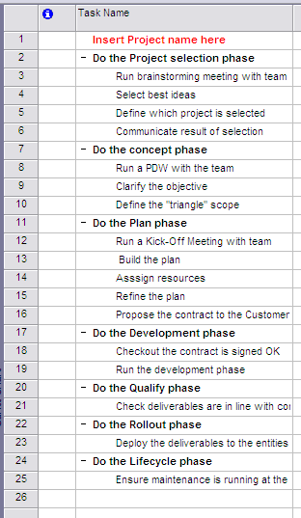

Example for a WBS template based on 7 phases
Action verbs

Slide 7
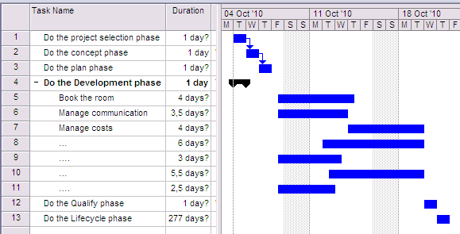
Example for small project
WBS
GANTT CHART

Slide 8
More on WBS…
A WBS line starts by an Action Verb (“manage the team”, or “build the wall”, etc. )
WBS Objective is to list all needed activities for planification, estimates, budget, measurement of performance, tests, changes...
WBS builds the project, it is a reference for the stakeholders, independently of the organizations, the financing, the systems of accountancy.
WBS clarifies the responsibilities. It is objective-oriented, it identifies pragmatic deliverables…

Slide 9
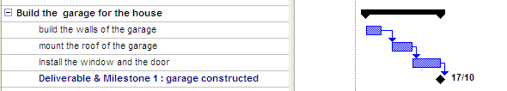
Milestones and Deliverables
Each milestone corresponds to a deliverable
Milestones are used to provide high-level view of the plan
Deliverables are visible on the contract
A milestone is a zero-duration, zero-cost task

Slide 10
Assignment 3 : WBS/OBS
1 - Detail the WBS, Limit to 30 lines. Use a spreadsheet software so you can easily copy/paste later in a Project Management Software.
2 - Write down the OBS of your project (which role for which person)
Preparation 30 minutes, presentation 5 minutes, sharp.
Notes:
Exercice No 3

Slide 11
Business Plan
Business Case
Business Value
The Business plan is a summary document that will present a business project. Intention is to get money from the sponsor. (example I will create a company – here is its market, its products, its investments and returns, etc)
The Business case presents the direct return on a given project. It is part of the Business Plan (example: Cost 1M€; savings 8 Headcounts = 0,8 M€; payback 10 months)
The Business value concept goes one step further and presents the benefits of the project to the business with committed business measurements (example the new outsourced expense account chain will allow sales reps to spend more time at customer sites – generating +2% more sales)
Notes:
Le »business case » permet de jauger de la valeur d’un projet.
La « Business value » donne une vision client du projet

Slide 12
Risk Mgt
Notes:
Gestion des risques

Slide 13
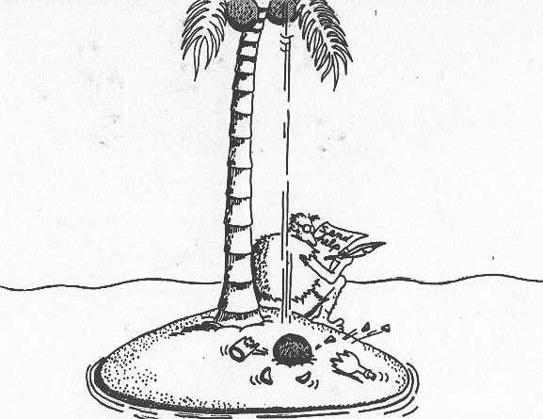
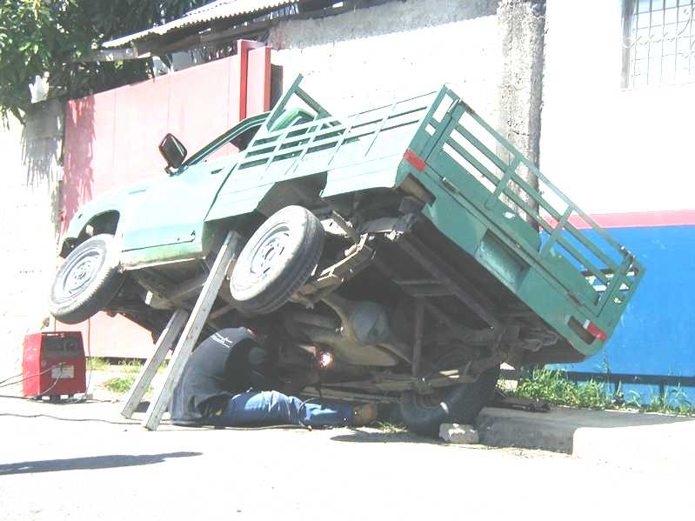

Risk management
Notes:
Le risque est un mélange d’opportunités et de menaces.

Slide 14
Definition
A possible undesirable occurrence which could result in the project not meeting one or more of its objectives
The exposure of undesirable consequences
13
Notes:
Définition : un évènement indésirable aux conséquences fâcheuses.

Slide 15
Risk drivers
External : Introduced by factors outside the project management (eg weather, social)
Induced : Introduced by bad planning or bad control (eg requirements badly defined)
Intrinsic : Caused by the nature of the project and the circumstances (eg New technology)
Imposed : Contract Terms & Conditions can make objectives unachievable (eg Performance)
Notes:
Ces 4 facteurs de risque coexistent : de l’intérieur, de l’extérieur, imposés ou induits.

Slide 16
How to manage the risks in a projects ?
Step 1 - Run a Brainstorming session (RIW, Risk Identification Workshop) with proposal team, sponsor, technical gurus : Quantify / Assess Impact & Probability for each risk, using team specialists judgment, or checklists, or expert tool,
Step 2 - Position the risks on a prioritisation matrix,
Step 3 - Evaluate the cost of their action plans (contingency + mitigation) and decide on a risk response for each one. Then evaluate the consequent cost increase on the project & get formal approval.
Then, implement the risk actions within the WBS and organise monthly risk reviews and update the plan as necessary.
RIW + regular (monthly?) reviews
RIW
Notes:
Méthode pour identifier et gérer les risques : une session d’identification µ+ des revues régulières.

Slide 17
Step 1 – Identify the risks, evaluate probability & impact
before
after
Risk driver -(EXT, IND, INT, IMP) | Which Impact on project ? | Probability Level | Proposed Contingency action * (reduce probability for the risk ho tappen) | Impact Level | Proposed Mitigation action* (reduce impact after the risk happened) | Risk Owner
It may rain (EXT) | People are wet & can’t work | L | N/A | L | Use raincoats | Joe
Resources may not be available (EXT) | Supply chain may be stopped | H | Outsource supply chain | H | N/A | Mark
There is a new technology involved (INT) | Project may be in jeopardy | H | Use few new technology | M | Train people on new technology | Ralf
Quality may not be at the right level (IND) | Deliverables may be poor | M | Implement ISO 9000 | H | Implement ISO 9000 | Stella
Volumes could be greater than expected (EXT) | Customer may lack products | M | N/A (this is a positive risk) | H | Add a clause to transportaiton contract for flexibility | Guillaume
* Lat. Contingentia – chance Mitigare – smoothen
Notes:
Cette matrice est essentielle et permet de contrôler chaque risque.
Il s’agit de préventif et de curatif.

Slide 18
Step 2 – Position the risks in a prioritisation matrix
Low Occurrence >> High
Resources may not be available
There is a new technology involved
Quality may not be at the right level
Volumes could be greater than expected
Low Impact >> High
Attack those risks first
It may rain
Notes:
Cette matrice est utilisée pour prioriser les risques.

Slide 19
Step 3 – Estimate the cost of action plans and make decisions
Risk driver | Which Impact on project ? | Probability Level | Impact Level | Proposed Contingency action * (reduce probability before the risk happens) | Proposed Mitigation action* (reduce impact after the risk happened) | Decision | Cost of the decided risk action plan
It may rain | People are wet & can’t work | L | L | N/A | Use raincoats | Ignore risk | 0 $
Resources may not be available | Supply chain may be stopped | H | H | Outsource supply chain | N/A | Transfer risk to another organization | 5 K$
There is a new technology involved | Project may be in jeopardy | H | M | Use few new technology | Train people on new technology | Establish Contingency only (no mitigation) | 15 K$
Quality may not be at the right level | Deliverables may be poor | M | H | Implement ISO 9000 | Implement ISO 9000 | « Contain » risk Contingency + mitigation) | 200 K$
Volumes could be greater than planned | Customer may lack products | M | H | N/A (this is a positive risk) | Add a clause to transportaiton contract for flexibility | Establish Mitigation | 4 K$
* Lat. Contingentia – chance Mitigare – smoothen
Notes:
Cette matrice est essentielle et permet de contrôler chaque risque.
Il s’agit de préventif et de curatif.

Slide 20
Risk Mgt vs. Issue Mgt
problems*
Risk management
issues
Issue/pb management
List the risks that may affect the project.
Try to reduce their probability to happen
Try to reduce their impact pro-actively
Prepare up-front a procedure to address any issue/pb that may arise (escalation paths, etc)
Apply this procedure whenever an issue/pb occurs.
* Problems are issues that have not be already identified as consequences of risks

Slide 21
More about…risk actions & plans
Each Risk action will be tracked within the project management system
Each risk action is included in the WBS (ie augments the scope of the project)
Each Risk action is weighed in dollars and increases the cost of the projet – the decision to address a risk or not will impact the planned cost of the project.
The Risks may be shared with the Customer or not, depending on the situation
Notes:
Chaque risque doit avoir un plan associé.

Slide 22
What you learned
Zero risk does not exist
Risks must be managed all over the project duration
What is Risk Identification Workshop / Risk matrix / Risk prioritisation ?
Have the “risk attitude”: attack the risks before they attack you
Notes:
En résumé, le risque zéro n’existe pas. Vous devez avoir une attitude pro-active.

Slide 23
Assignement 4 : Risks
Use your existing project
1 - Run a RIW : Identify 3-4 risks
2 - Build the risk table (list of risks and contingency / mitigation)
3 - Build the risk matrix (prioritisation)
4 - Make decision for each risk (ignore / mitigate / etc)
Preparation 15 minutes
Presentation 10 minutes
You should convince your audience (sponsor) that your team has a good risk approach.
S/he should understand this approach is necessary for the project to be successful
Notes:
Exercice sur les risques

Slide 24
Time / Change Management
Notes:
Gestion du temps

Slide 25
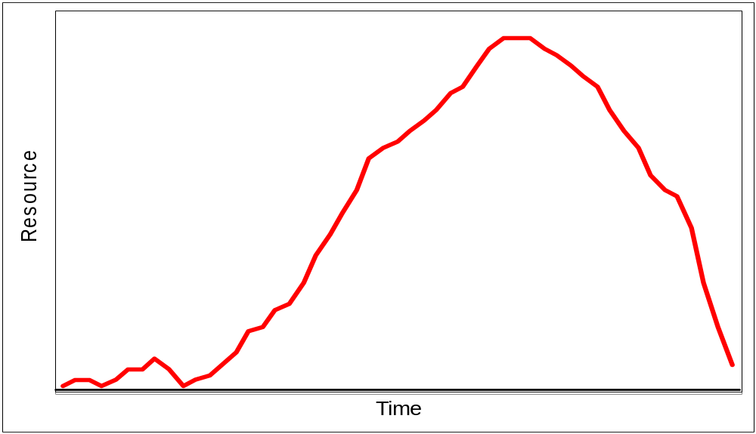
Distribution of effort
Qualify
Deploy
Concept
Plan
Develop
Proposal
Delivery
Contract Signed
Proposal
Delivery
Signature
“in cauda venenum”
Notes:
Rappel de la courbe de distribution au cours du temps

Slide 26
A project methodology for estimating
Step 2
Time
Estimate tasks durations
Step 1
define the scope (WBS)
Cost
Functions
Step 3
Defining the scope first and estimate time & costs afterwords avoids missing key tasks
Estimate costs
Notes:
Voici une méthode pour estimer le cout et la durée d’un projet :
1 – WBS
2 – temps individuels
3 – couts individuels

Slide 27

time management
« How can we manage time in a more efficient way ? »
« How can we do in one day all those things we have to do ? »
This is one empty glass bottle…there is plenty of « time left » in it, right ?
We fill it up with big stones…any time left?....
Then with small stones…time left?..
Then with sand…no time left ???....
Then with water…
Morality ??
Morality one : there is always some time left to do something urgent
Morality two : if we had started with water…no « big stone » would have entered…
Tip 1 : match your « to-do list » to your « priority list »
Tip 2 : think about leaving spare time for contingency
Notes:
Ces exemples montrent combien le temps nécessite de la discipline.
Ces méthodes simples permettent d’augmenter l’efficacité.

Slide 28
Work time estimation
Year 365
Week ends 104
Holidays 12
Vacations 25
Illness 5
Education 10
Meetings 3
Other ?
Admin ?
Help other ?
Days worked 200 days
Various methods to estimate durations
Top-Down-analogic method (-25 / +75%)
Simulation Modelisation (eg Montecarlo) method (-10 / +25 %)
Bottom-up method (-5 / +10%, but much longer to do)
“It is better to be roughly right than precisely wrong.” John Maynard Keynes (1883-1946)
Notes:
Selon les pays, le « temps de travail » peut varier. On compte en général 200 jours
Travaillés. Les méthodes d’estimation sont plus ou moins précises selon l’effort
qu’elles nécessitent.
La plus recommandée est « bottom-up ».

Slide 29
(Cost x Time) Management:
Earned Value Methodology (optional)
$
EAC
VAC
ETC
BAC
ACWP
BCWS
SV
SPI
CV
CPI
variance < 0 = danger
perf. index < 1 = " "
BCWP
ACWP : actual cost of work performed
BCWS : Budgeted cost of work scheduled
BCWP : budgeted cost of work performed
ETC : estimate to complete
EAC : estimate at completion
BAC : budgeted at completion
TCPI = (BAC-BCWP)/(BAC-ACWP)
Notes:
Cette méthode « de la valeur gagnée » permet de comparer deux ou plusieurs
projets dans leur avancement.
Il faut en connaître ici le principe mais non les détails.

Slide 30
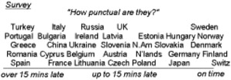
Schedule Management
It is impolite to be late for some cultures and always uncomfortable in projects
From : « mind your manners »
Notes:
Gestion de l’ordonnancement.

Slide 31
Why do we schedule & plan?
To answer the question: can you deliver on time or before ?
To assign tasks to practitioners
To do project tracking
To communicate the team
To see the impact of changes
Notes:
La planification et l’ordonnancement sont nécessaires; notamment pour une bonne
Communication.

Slide 32
Standard for task representation
(CPM-Critical Path Method)
Early Start
Early Finish
Task
Duration
Late Start
Late Finish
Note : other methods are :
PERT method is based on probabilities: Average duration is (o + 4m + p)/6
GERT and CDM (conditional diagraming method) allow loops and dependancies
Notes:
Voici le modèle de reporésentation de la méthode CPM (méthode du chemin critique)
ES : date de fin au plus tot, EF : date de fin au plus tôt
LS : date de début au plus tard, LF : date de fin au plus tard.

Slide 33
CPM : Example
All precedences are “FS” (Finish to Start) by default
6
9
2
2
5
3
12
Questions are :
what is the project duration ?
What is the critical path ?
Notes:
Passe avant : pour déterminer la durée du projet.

Slide 34
First step : forward pass
(calculating from left to right)
3
9
9
18
6
9
1
3
9
11
2
2
11
16
18
21
5
3
3
15
12
Can start at day 0 or day 1 – your choice
Forward pass gives the project duration : 20 days
Notes:
On démarre habituellement au jour zéro – la durée est ici de 21 jours.

Slide 35
Second step : backward pass
(calculating from right to left)
3
9
9
18
6
9
3
9
9
18
1
3
9
11
2
2
11
16
18
21
5
3
11
13
18
1
3
13
18
21
3
15
12
6
18
Backward pass gives the critical path
Notes:
Passe arrière : calcul de droite à gauche

Slide 36
Define the Critical Path
3
9
9
18
6
9
3
9
9
18
1
3
9
11
2
5
2
11
16
18
21
3
1
11
13
18
21
3
13
18
3
15
12
6
18
Critical path is where EF=LF (or ES=LS)
They are the tasks to concentrate on.
Notes:
On voit le chemin critique, qui est fait de l’ensemble des tâches critiques
(celles ou les chiffres du haut sont identiques à ceux du bas).

Slide 37
About...relations between tasks
& task constraints
Recognize task
constraints such as ALAP, ASAP, FNET, FNLT, MFO, MSO, SNET and SNLT.
Understand relations between tasks : FS / SS / FF.
3
3
Notes:
Il y a d’autres éléments : les relations entre tâches, les contraintes, les tâches fantômes.

Slide 38
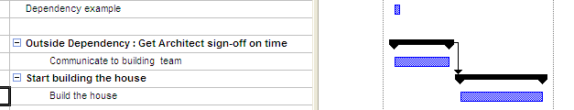
About dependencies
Each dependency should be listed as a separate summary task.
Each external dependency should be linked to a task.

Slide 39
Assignement 5 : Scheduling
Notes:
Exercice sur l’ordonnancement.

Slide 40
Step 1 - Build the initial schedule
Input project plan
Verify defaults
Establish calendars
Assign resources
Examine task dependencies
Notes:
Première étape : construire le plan initial

Slide 41
Step 2 - Optimise the Schedule
Objective :
  Shorten time
  Reduce costs
  Improve resource
Two main methods :
  Crashing (re-schedule)
  Fast tracking (Try to run tasks in parallel)
More tips:
  Try FF instead of SF
  Add people
  Put more productive people
  Implement new productivity tools to decrease durations
Notes:
Deuxième étape : optimiser le planning

Slide 42
Step 3 – Do tracking
Save your baseline
Consider Done vs. Planned
Check people availability
Balance resources
Reschedule
Notes:
Troisième étape : effectuer le suivi

Slide 43
Step 4 - Handle changes
A new set of approved requirements comes up
(new functions, new people, new constraints, new
budget, new timeframe…)
Assess impact & induced risks (teamwork)
Propose plan of actions
Get written agreement
Store actions and decisions in the PCB (Project Control Book)
Communicate
Nota 1 : the change management procedure must have been defined upfront (at concept phase) and should be followed.
Nota 2 : improper change management is a major driver for project failure
Notes:
Quatième étape : gérer les changements

Slide 44
What are the key documents and meetings in a project ?
Kick-Off
meeting
PDW
Steering
Committee
meetings
Kick-Out
meeting
Core Team
Meetings
RIW
Qualify
Deploy
Concept
Plan
Develop
PCB
PDR
Project
Charter
Team
Charter
PDW Project Definition Workshop
RIW Risk Identification Workshop
PDR Project DefinitionReport
PCB Project Control Book
Notes:
Ce graphique reprend les éléments essentiels en termes de réunions et de documentation

Slide 45
Documentation management /
Intellectual Capital
Project Control Book
  Project / team charter
    Project high-level content
    Draft Roles and Responsibilities
    Scope / team / budget control
  PDR
    OBS
    PBS
    WBS
    Plan
    Project Management Information System
  Risk Register
  Issues Register
  Actions Log
  Meeting minutes
  Contracts details
  Lessons learned
Notes:
Il convient de mettre à jour la base de l’entreprise qui contient les « leçons apprises »
Lors de chaque projet

Slide 46
Project Management Discipline
Maintain an Issue Register
Maintain an Action log
Maintain a Risk Register
Maintain a Lessons Learned Register
Maintain a « Fridge» Register (for open ideas)
Notes:
La discipline qu’impose la gestion de projets se retrouve dans ces éléments qu’il
Faut maintenir actifs :
Un registre des problèmes, des actions, des risques, des idées à garder, et des leçons
apprises

Slide 47
Conclusion
Be ready to track, update and optimise your schedule
Differentiate Gantt chart vs Network chart
Know the way to build and maintain a schedule
Notes:
Conclusion – il faut comprndre les principes et processus associés.
Qu’est-ce q’un diagramme de Gantt chart et un diagramme en réseau ?

Slide 48
International Enterprise Project Management Tooling
example of Open Project
Notes:
Example de MS project et de Open Workbench

Slide 49
PM Softwares vs. Project Size & Complexity
# WBS lines
10000
Create subprojects
Corporate tools
RPM, ESE, PMP, PMO,
1000
Open Project (*)
MS Project
100
spreadsheets
Use Communication tools
Web site, Notes, etc.
10
1
10
100
1000
# stakeholders
(*) Other products : M/S Project Primavera; PSN, Open plan, Augeo, Superproject, Gantt project…
Notes:
A chaque taille d eprojet correspond son logiciel.

Slide 50
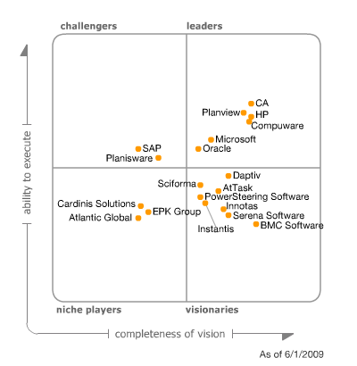
Gartner’s magic PPM quadrant
Open Project is produced by Serena Company
Notes:
Sur ce diagramme, on voit Open Office ‘(une partie de Clarity) en haut du schéma, et MS projet en milieu : facile à utiliser, mais manque de fonctionnalités.

Slide 51
Project Tooling comments
# of stakeholders is the key factor for complexity.
Having +10 persons using a same MS project requires to run a specific project (education, refresh, etc)
MS project is a good vehicle for communication
Notes:
Par expérience, le nombre de participants est une facteur de complexité.

Slide 52
Methodology for creating a new project
Enter the WBS (use verbs)
Enter the tasks durations & dates
Enter resources (table)
Assign ressources
Enter constraints & dependencies(FS, SS, etc)
Optimise the schedule & resources
Notes:
Méthode : entrer le WBS, puis les durées et les dates.
Remplir le tableau des ressources, puis assignere les resources aux tâches.
Entrer les contraintes et les dépendances
Optimiser le planning

Slide 53
Notes on the methodology
The proposed methodology ensures that you focus on the project triangle (« scope ») and don’t forget any task (« cost » approach)
Sometimes is it more intuitive to do I, II and V at the same time (« draw a plan »)
Don’t use too many tasks dependencies. It will become unmanageable
Notes:
Cette méthode permet de ne pas oublier de tâches.
Eviter trop de dépendances, qui rendent vite le projet ingérable.

Slide 54
MS Project 2007 tips
Define Project start date : Projet – information sur le projet
Define schedule (mon-fri for example) : Outils – Options – Calendrier
Define currency (USD) : Outils – Options – affichage
Define hourly and overtime rates : File-options- General
Switch from GANTT to NETWORK diagrams : Affichage – diagramme de Gantt
View resource sheet : Affichage – tableau des resources
View reports : rapports – rapports visuels

Slide 55
MS Project 2010 tips
Define Project start date : Project-Project information
Define schedule (mon-fri for example) : File-options-Schedule
Define currency (USD) : file-options-display
Define hourly and overtime rates : File-options-Advanced
Switch from GANTT to NETWORK diagrams : View-Network/Gantt
View resource sheet : View-Resource Sheet
View reports : view-visual reports

Slide 56
Open Project Education
2 main views :
  « Gantt »
  « Network»
  “Resources”
Download from http://www.projity.com/
Notes:
Formation MS Project
(2000, 2003)

Slide 57
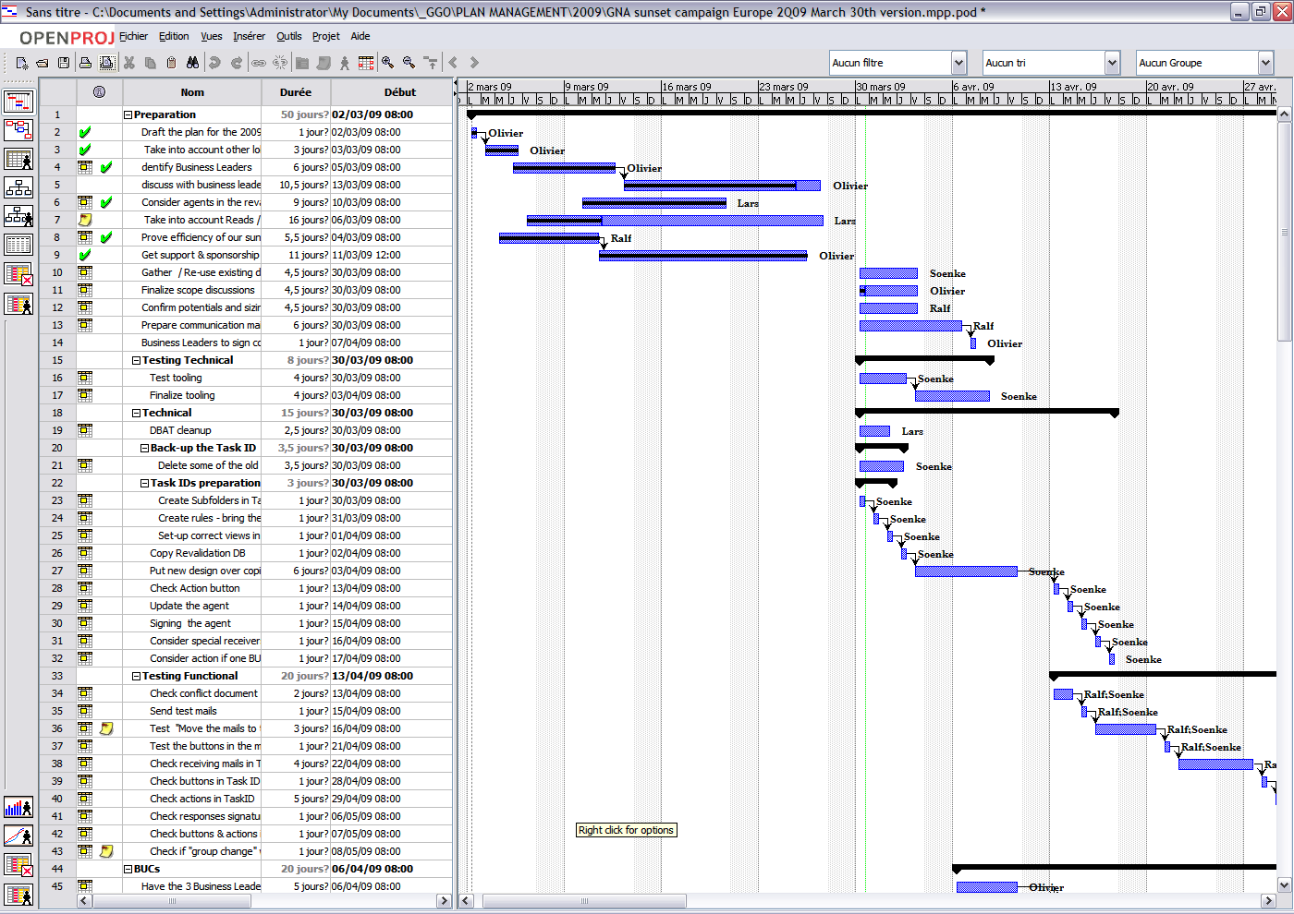
Main view : Gantt Chart
Notes:
Diagramme de Gantt

Slide 58
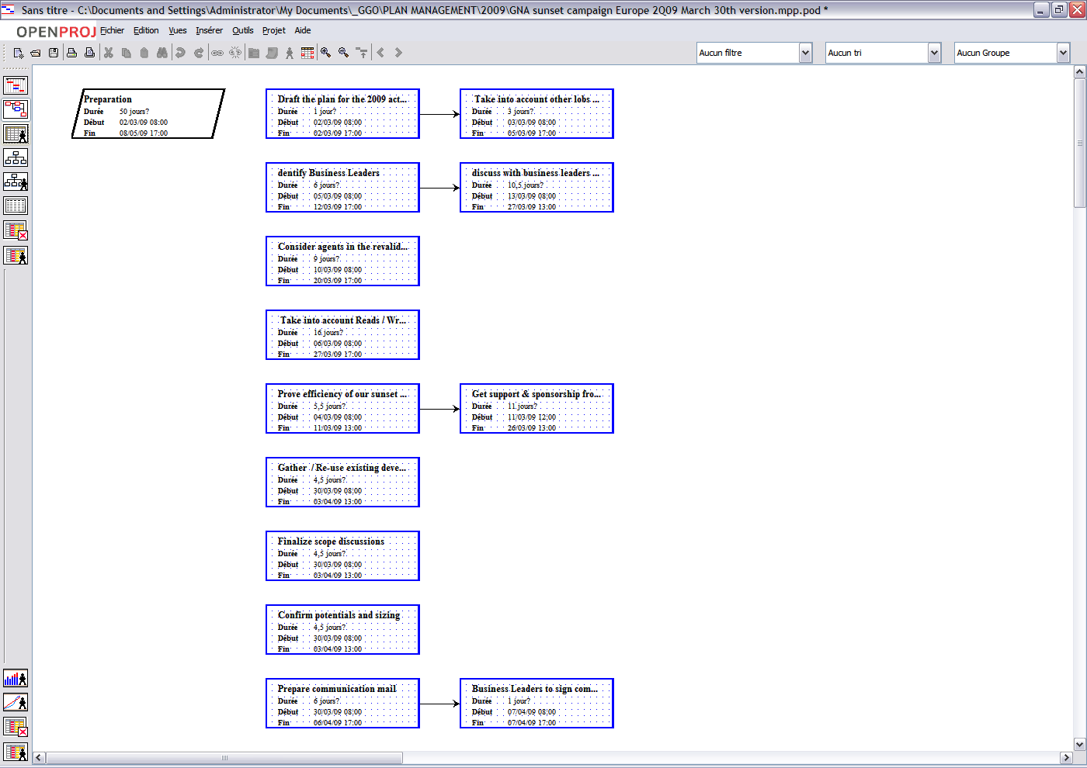
Network Diagram
Notes:
Diagramme en réseau

Slide 59
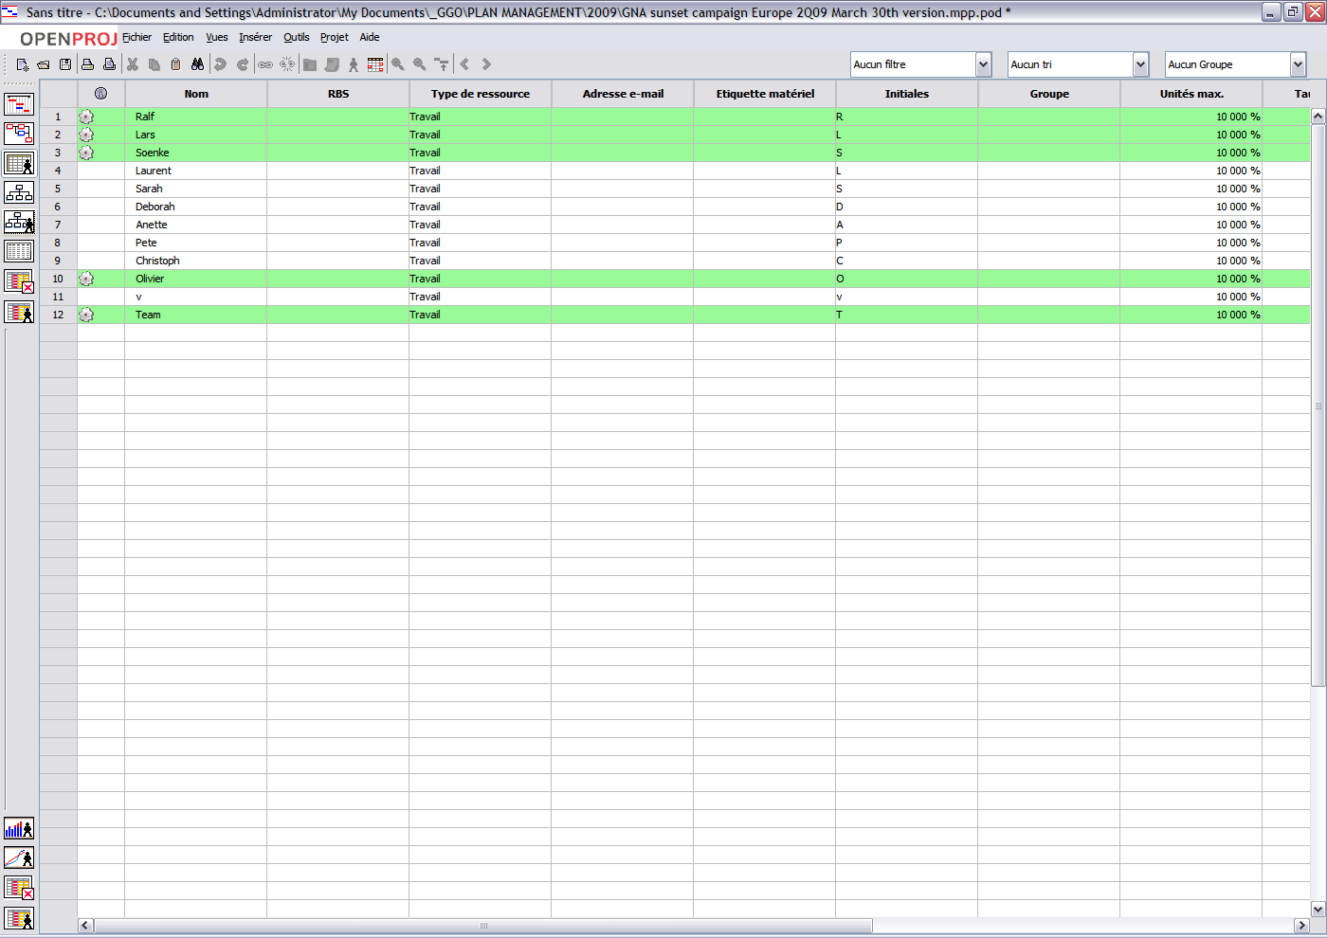
Resource table
Notes:
Utilisation des resources

Slide 60
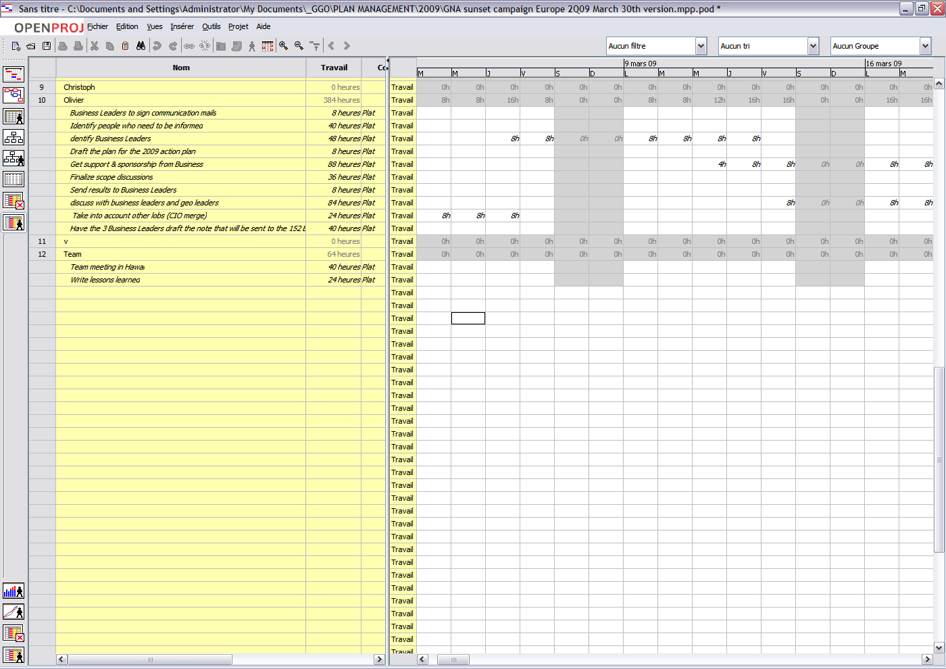
Resource usage

Slide 61
I. Enter WBS
Open Open project
Double click on icon
Enter a project name
’File-save as ’
Enter project start date
’Project - Information’
Select Gantt view
‘view - Gantt’
Enter first task
‘task name ’ field
Enter second task
Use ‘enter’ key
Create subtasks
Use ‘indent’ arrows
File
‘file’
Notes:
Etape 1 – entrer le WBS

Slide 62
II. Enter Task Durations & dates
Select Gantt view
‘view - Gantt’
Enter task 1 start & end dates
Click in columns ‘start’ and ‘finish’
Enter task 2 start + duration
Click in columns ‘start’
Click in column ‘duration’
Enter next tasks durations & dates
Copy/Paste
Or- drag/drop
Or- double-click
File
‘file’
Notes:
Etape 2 – entrer les durées et les dates

Slide 63
III. Enter Resources
Select Resource view
‘view - Resources’
Enter Resource 1 name
Click in second column, type name
Select resource type “work”
Use drop-down list in column 4
Enter standard rate
Type in column 10 (40€ per hour)
File
‘file’
Notes:
Etape 2 – entrer les durées et les dates

Slide 64
IV. Assign Resources
Select Gantt view
‘view Gantt’
View ‘resource name’
Draw curtain to the right
Enter name 1
Drop-down list
Enter all names
Copy/paste
File
‘file’
Notes:
Etape 4 – assigner les resources

Slide 65
V. Enter Constraints & dependencies
Select Gantt view
‘view-T.Gantt’
Link tasks 1 & 2
Select tasks 1&2 and click on ‘link tasks’ icon
Link tasks 1 & 3
Double-click task 3
Select ‘predecessor’
Enter ‘Task 1’
Create all major links
Check durations / dates
File
‘file’
Notes:
Etape 5 – entrer les contraintes et les dépendances

Slide 66
VI. Optimize cost & schedule
Select Gantt view
‘view-Gantt’
View critical path
Appears in red
Try to parallel tasks
Try to assign more resources
File
‘file’
Notes:
Etape 6 – optimiser les couts et le planning

Slide 67
Open Project / Microsoft Project assignment
Enter 50-lines WBS
Enter / assign resources
Enter constraints and
Optimize planning
Produce reports
Target
Check the initial (triangle) budget is in line with the Bottom up estimate from the WBS in MS Project
Show the resources are leveraged
Notes:
Examples de sujets d’exercices

